Slide 1
Box Office Gross Prediction
Sabrina Yang
Metis 2021.6.11
Notes:
Movie & Box Office Gross / Prediction/ Linear Regression
Predicting Domestic Box office

Slide 2

AGENDA
03.
RE S U L TS
02.
A P P R O A CH
01.
INTRO
F U T U R E
05.
APPE NDI X
04.
W OR K

Slide 3
INTRO
01

Slide 4


Domestic Box Office Gross
#1
#2
#3
$939 M
$8 5 8 M
$760 M
2019
2009
2015
Notes:
Historical

Slide 5



Top 3 Domestic Grossing Movies
$8 5 8 M
$760 M
$939 M
2019
2009
2015
Notes:
Historical

Slide 6
Approach
02

Slide 7


Outcome
Predict total domestic gross box office

Slide 8
Features
Top Lifetime Gross by MPAA Rating ( Domestic)
Individual Movie Profile
Page
Title
Lifetime Gross
Distributor
Budget
MPAA Rating
Rank
Year
Runtime
Release Date

Slide 9
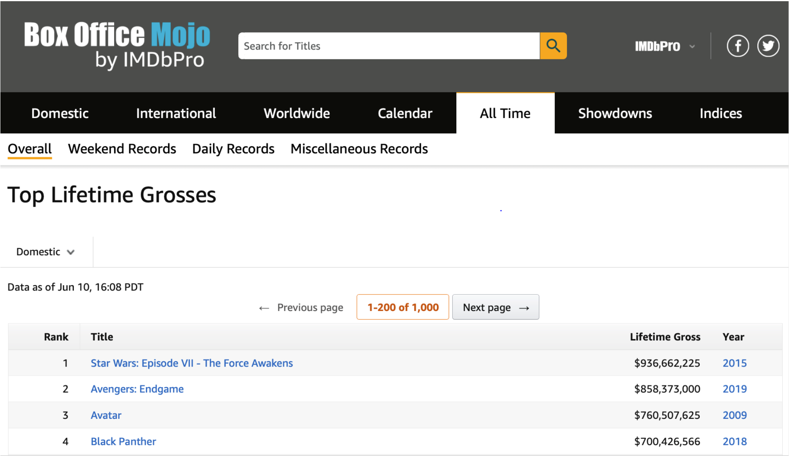
Data Resources
Web-scraped from BoxOfficeMojo.com
1980 – 2020
Wide Release
847 Movies
Notes:
1200

Slide 10
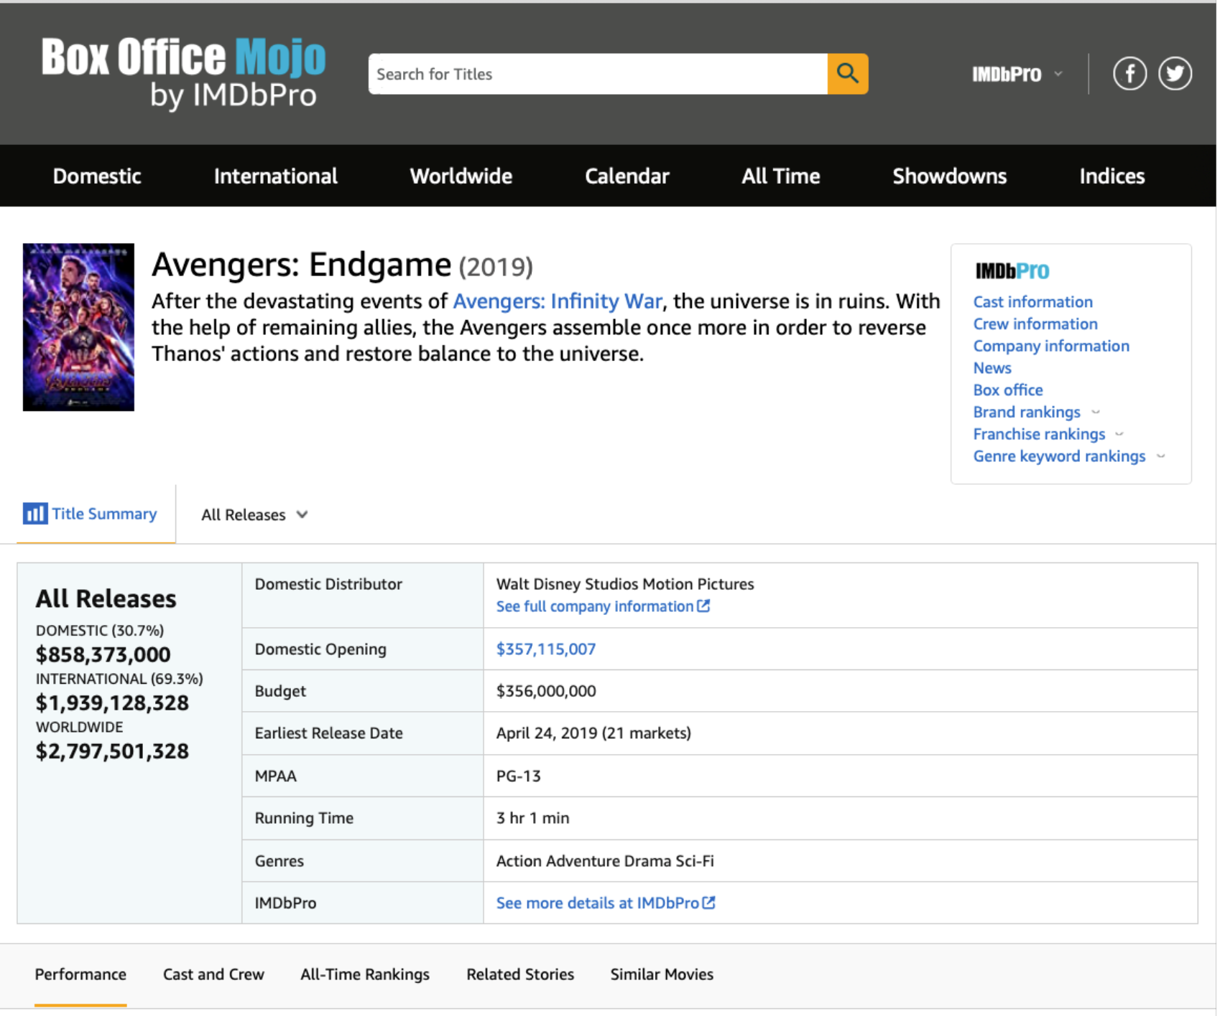
Data Resources (Cont.)

Slide 11
Results
03

Slide 12
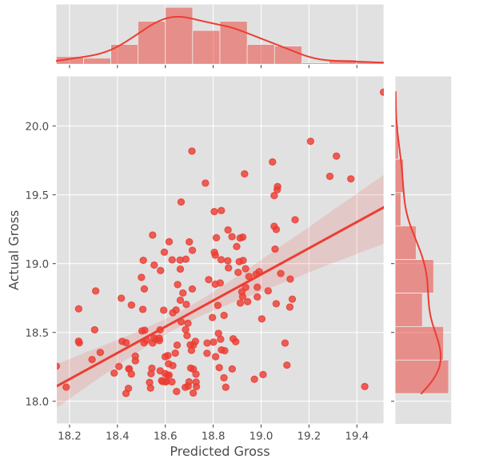
Lasso CV
0.330
R^2
0.327
MAE
Residuals
Predict (IMDb User Rating)
Log Adjusted Gross

Slide 13
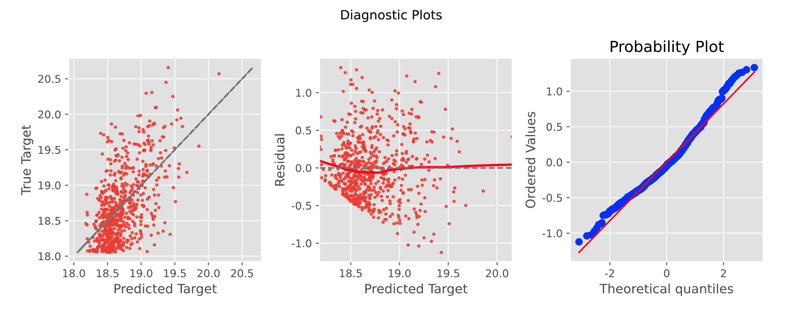
Lasso CV
Log Adjusted Gross

Slide 14
Key Movie Features
Summer
Season
PG-13
Rating
High
Budget
DreamWorks
Distributor
Notes:
movie studio sometimes release thier movie a few months piror to oscars ( April 25)
thisis so movies will be fresh in the minds of viewers.
so some of good movies wait to release around spring/ summer

Slide 15
FUTURE WORK
04

Slide 16
1
Genre Analysis
3
Time Series
2
Cast and Crew Analysis
4
Additional Web Scrapping

Slide 17







THANK YOU

Slide 18



APPENDIX

Slide 19
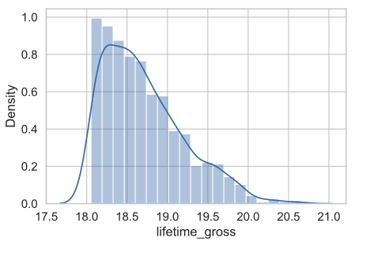
Histogram of DEPENDENT VARIABLE(Log)
APPENDIX

Slide 20
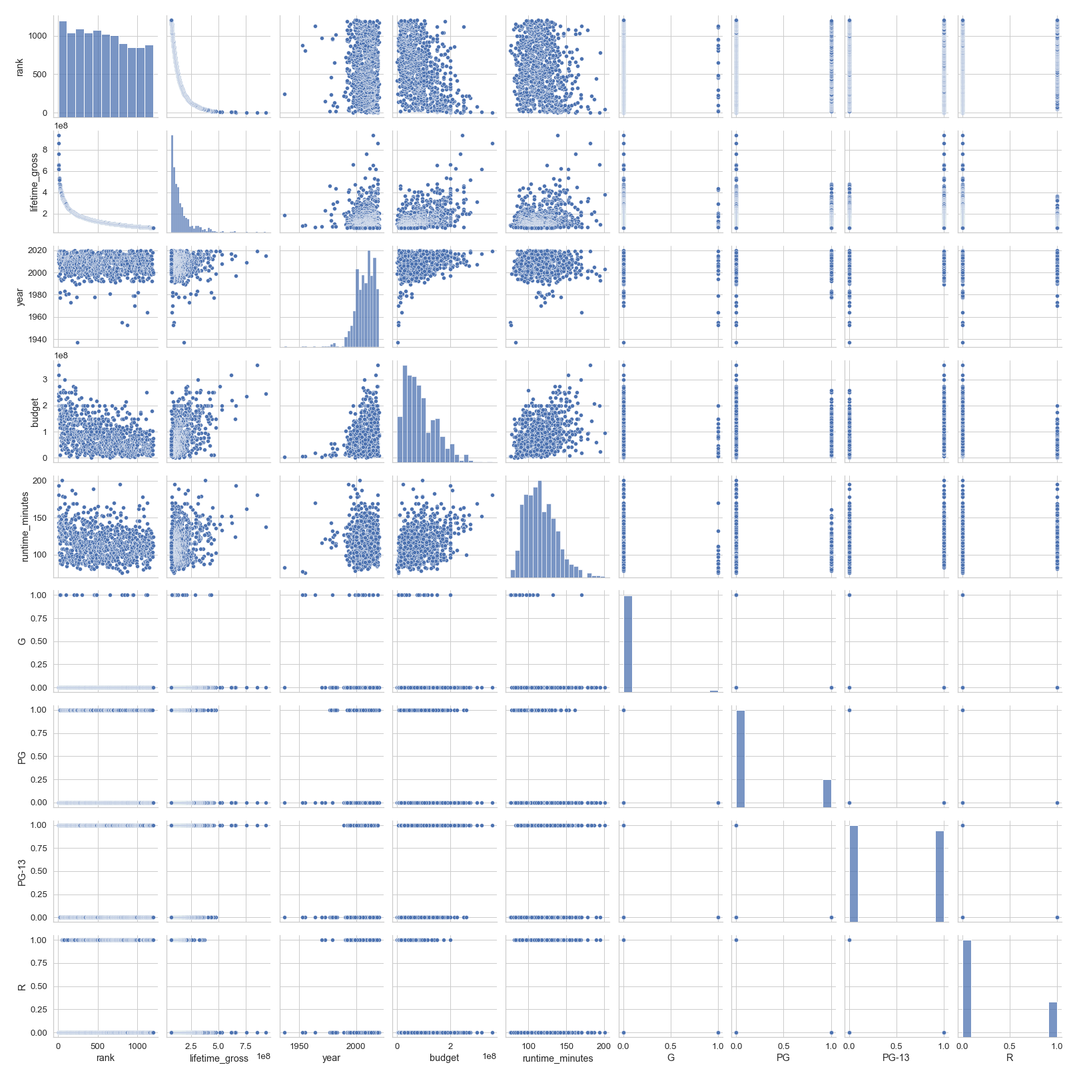
Pairplot
APPENDIX

Slide 21
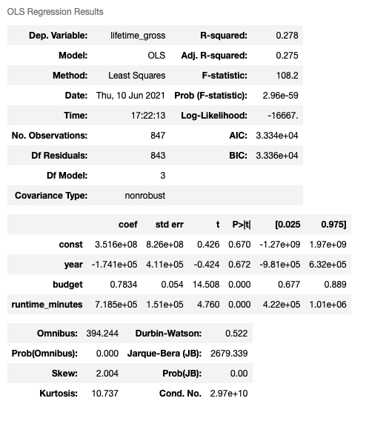
APPENDIX
O L S summary

Slide 22
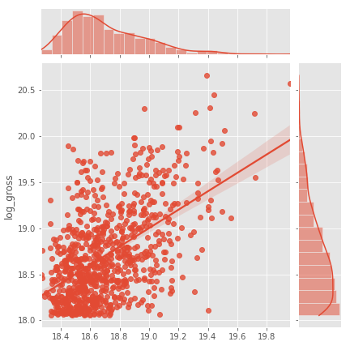
APPENDIX
jointplot

Slide 23
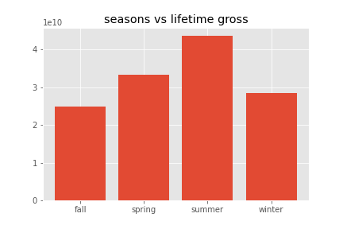
Season vs Gross
APPENDIX

Slide 24
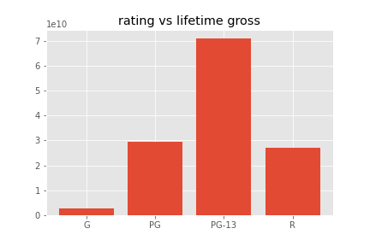
Rating vs Gross
APPENDIX

Slide 25
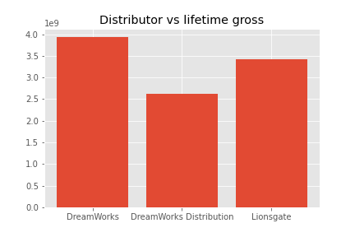
Distributor vs Gross
APPENDIX

Slide 26
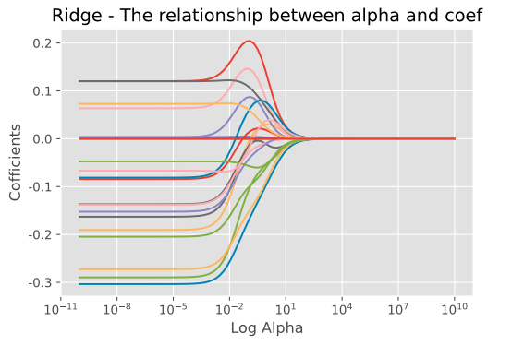
Ridge & Alpha
APPENDIX

Slide 27
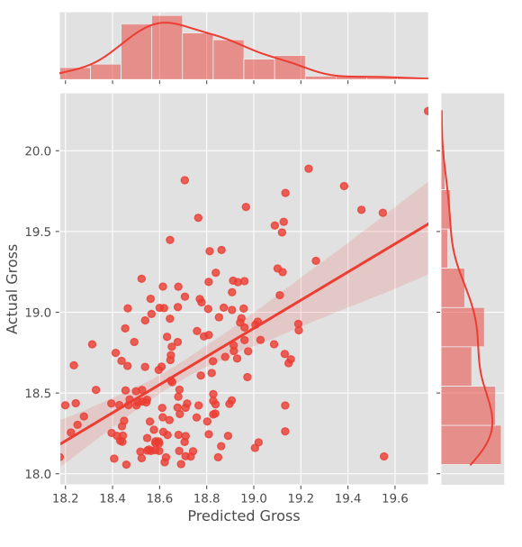
Ridge CV Predicted vs Actual Gross
APPENDIX

Slide 28
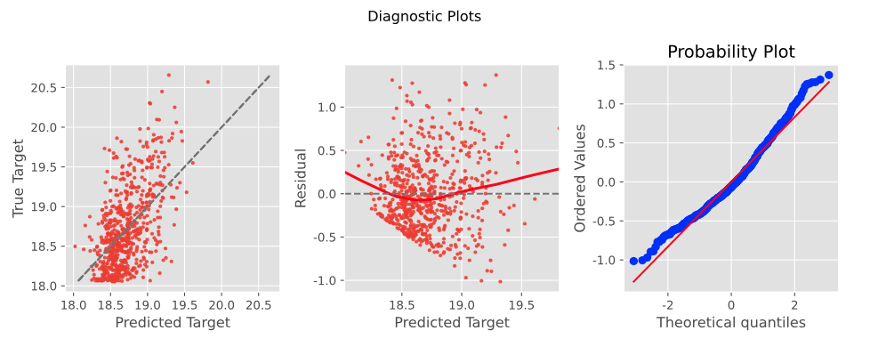
Ridge CV Regression Fit, Residual plot, Q-Q Plot
APPENDIX

Slide 29
Lasso CV Predicted vs Actual Gross
APPENDIX

Slide 30
Lasso CV Regression Fit, Residual plot, Q-Q Plot
APPENDIX

